Slide 1
Procure to pay (P2P) process
NAME : HARI VISWESH MCA (SS)
REG NO : 2019272009
Guide : Ms.S.Kanimozhi
Teaching Fellow

Slide 2
INTRODUCTION
The procure-to-pay (P2P) process combines a company’s procurement and accounts payable functions. The process starts when the need arises for goods or services and ends with the payment for those goods or services.
It’s aim is to make the entire production resources chain as fast, secure, and cost-effective as possible.
The Purchase Order Process, during which:
Purchase requisitions are created and approved.
Vendors are evaluated and selected.
Purchase orders are issued for the required goods and services.
The Receiving Process, during which:
Goods and services are received or executed.
For goods, receiving documents are reviewed and logged.

Slide 3
The Invoice Approval Process, during which:
Invoices are received and invoice processing completed.
Invoices are reconciled and cross-checked with the original PO and goods receipts or receiving documents (three-way matching).
Errors are recorded and corrected.
Approved invoices are paid

Slide 4
Over view
Problem statement
Module
TOOLS AND FRAMEWORK:
Front End: HTML5, CSS3, Bootstrap
Back End: PHP, MYSQL
Control End: Java Script

Slide 5
PROBLEM STATEMENT:
Rushing to Place Orders
In some cases, your purchasing department might place an order with a preferred vendor without checking with others to look for discounts or special offers.
If this is the case, your business might be spending more on essentials items than it needs to pay. You want to have a way for your company to price check your top purchases and comparison shop vendors without wasting a lot of time or sacrificing quality.
Negotiating With Vendors
When you need materials or stock in your warehouse, it’s easy to just place the order and move on. However, as part of the procure to pay cycle, you want to get the supplies and raw materials for a price that helps you get the most bang for your budget.

Slide 6
PROBLEM STATEMENT:
Mistakes in Ordering
Whether your warehouse manager places orders online or handwrites them as the first step in the procure to pay cycle, there is always the chance that the wrong item can get ordered. It’s possible that the wrong number of an item gets ordered..
This crucial first step in the procure to pay cycle can have an effect on the other steps if not resolved immediately. It helps to have a good working relationship with all of your suppliers to resolve a mistake without it turning into a big deal.

Slide 7
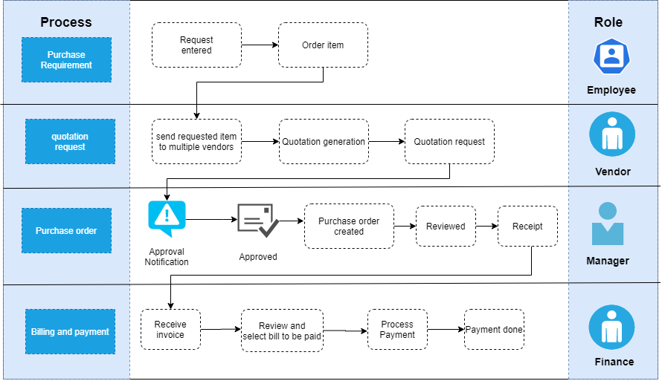

Slide 8
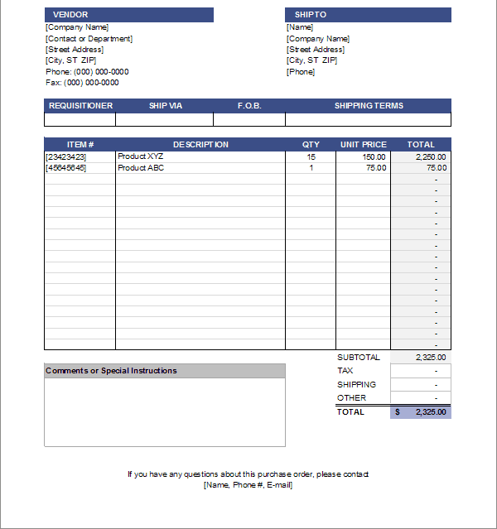
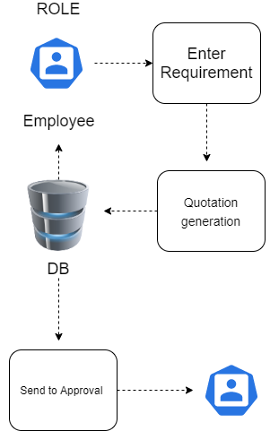
Vendor

Slide 9
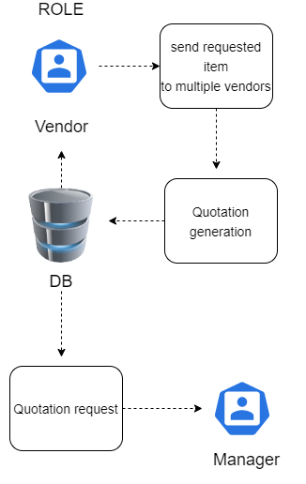
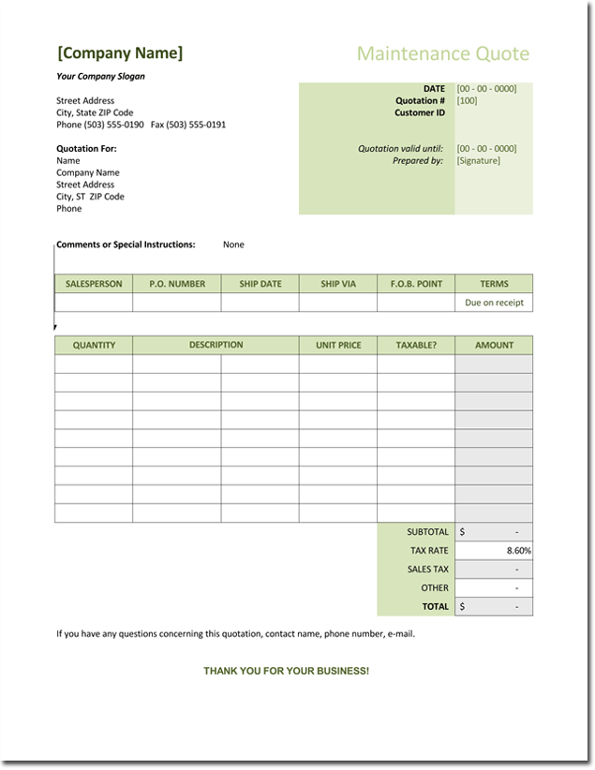

Slide 10
MODULE
Identify Needs
Create Purchase Requisition.
Generate Purchase Order.
Receive Purchase Order Approval.
Issue Goods Receipt.
Receive and Review Vendor Invoice.
Approve Vendor Invoice.
Pay Vendors Through Accounts Payable.

Slide 11
Thank you

